Slide 1


Hii,
Iam Siddhika
Welcome to Power BI Series
Part -56

Slide 2


I’m very excited to dive into this with you all!
Are you ready to enhance your data visualization skills?
We focus only on the most used and important Visuals
Today Content
VISUALIZING DATA
DASHBOARD DESIGN FRAMEWORK
THE REPORT VIEW

Slide 3


DASHBOARD DESIGN FRAMEWORK
Define the purpose Choose the right metrics
Present the data effectively
Eliminate clutter & noise Use layout to focus attention
Tell a clear story
follow it?

Slide 4


A well-designed dashboard should serve a distinct purpose for a distinct audience, use clear and effective metrics and visuals, and provide a simple, intuitive user experience.
got it?
Key questions to consider:
Who are the end-users of your dashboard?
What are their key business goals and objectives?
What are the most important questions they need answers to? How can I present information as clearly as possible?

Slide 5
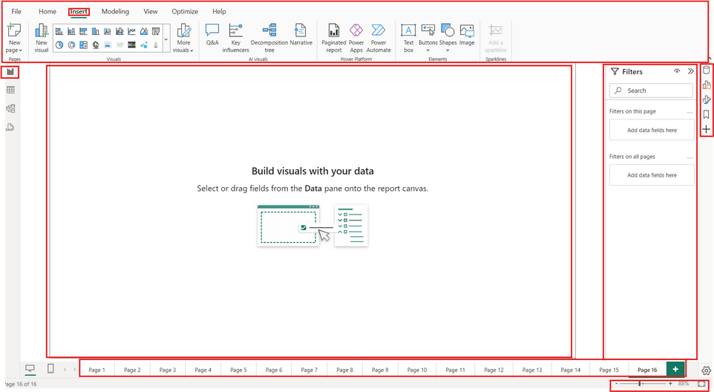

THE REPORT VIEW
Go and exlpore
Panes
(Data, Format, Bookmarks, Selection)
Insert Menu (Add pages, visuals, buttons, shapes, images, etc.)
Report View
Report Pages (each tab is a blank report canvas)
Filter Pane
(Page-level, report-level, visual-level filters)
View Options (Zoom, fit to page)
Report Canvas

Slide 6


Thank you for joining me today to learn about Part -56 of Power BI!
Remember, Effective data visualization is crucial for turning data into meaningful insights and compelling narratives with Power BI.
Stay tuned for more insights and tips on Power BI in our next Series.
Follow
Siddhika Shah

